Slide 1


PANIMALAR ENGINEERING COLLEGE
DEPARTMENT OF COMPUTER SCIENCE AND ENGINEERING
CS8811 PROJECT WORK
FINAL REVIEW
MEDILIFE Web Application with Random Forest Algorithm
Guide name: Mrs. K. Sangeetha
Assistant Professor
Team member:
Hariharan N R -211418104077
BATCH NO: E15

Slide 2


Introduction
In our day to day life we are facing more health issues, for that we consume tablets.
While consulting doctors they suggest tablets and we buy those tablets from pharmacies.
Some medicines prescribed by the doctor may not be available in a pharmacy.
We go in search of that medicines in other pharmacies, if it is not available in other pharmacies we again go to doctors to get alternate medicine.
This proposed system will overcome those situations.

Slide 3
Introduction Cont.
By using this application we can find in which pharmacy the required tablets are available.
If the tablets are not available we can get the alternate suggestion of tablet from the consulted doctor through this web application.
In this proposed system I have applied the concept of random forest algorithm on the feature subset selection and classification and regression to perform the comparative study of the random forest algorithm in different perspectives.
The experimental results are presented and discussed.

Slide 4
Literature survey
Authors | Title | Year | Source | Findings
Ethem Alpaydin | Introduction to Machine Learning | 2020 | Fourth ed. MIT. pp. xix | Machine learning programs can perform tasks without being explicitly programmed to do so. It involves computers learning from data provided so that they carry out certain tasks.
Hu, J.; Niu, H.; Carrasco, J.; Lennox, B.; Arvin, F. | Voronoi-Based Multi-Robot Autonomous Exploration in Unknown Environments via Deep Reinforcement Learning | 2020 | IEEE Transactions on Vehicular Technology | Machine learning algorithms are used in a wide variety of applications, such as in medicine, email filtering, speech recognition, and computer vision, where it is difficult or unfeasible to develop conventional algorithms to perform the needed tasks.
Piryonesi S. Madeh; El-Diraby Tamer E. | Role of Data Analytics in Infrastructure Asset Management: Overcoming Data Size and Quality Problems | 2021 | Journal of Transportation Engineering | Random forests generally outperform decision trees, but their accuracy is lower than gradient boosted trees. However, data characteristics can affect their performance.
Hastie, Trevor; Tibshirani, Robert; Friedman, Jerome | The Elements of Statistical Learning (2nd ed.) | 2008 | Springer | Random decision forests correct for decision trees’ habit of overfitting to their training set. Random forests are a way of averaging multiple deep decision trees, trained on different parts of the same training set, with the goal of reducing the variance.
Geurts P, Ernst D, Wehenkel L | Extremely randomized trees | 2006 | 24th ACM SIGKDD International Conference of Knowledge | As part of their construction, random forest predictors naturally lead to a dissimilarity measure among the observations. One can also define a random forest dissimilarity measure between unlabelled data: the idea is to construct a random forest predictor that distinguishes the “observed” data from suitably generated synthetic data.

Slide 5
Problem definition
Due to various reasons human being tends to visit hospitals for medical purpose and are directed to medication by doctor.
The problem here is not the factors, but the availability of medication prescribed by the doctor to the respective patient
Some medicines prescribed by the doctor may not be available in a pharmacy, or the prescribed manufacturer or the prescribed dosage or prescribed quantity may not be available at that particular pharmacy.
The patient can re consult the doctor for alternative which can be stressful and time consuming for them.

Slide 6
Problem definition Cont.
The unavailable medicine at one pharmacy can be in stock in some other pharmacies in the surrounding.
So the out of stock medicine can be easily brought with the help of our project.
The motive of this project is to make alternatives already prescribed by the doctor recently or frequently, or by randomly sampling the medicine from other nearby pharmacies with help of dataset presented in it.
To provide solution for the above mentioned problem efficiently and effectively.

Slide 7
Existing system
In the existing system, In this TAM model aim at increasing the probability of drawing a relevant topic from documents containing the given keywords while giving a relatively low probability to the other documents to prevent the overfitting problem.
The non-targeted documents from cluster occupying a larger percentage of the corpus will intrude into the related documents.
Once some irrelevant documents are wrongly clustered, words in them may be sampled as the focused terms by the current focused topic models.
And the error will propagate to the later calculation and cause the false propagation.
Difficult to classify nontargeted documents and running time is more, Difficult to perform a binary clustering task for targeted topics analysis.

Slide 8
Proposed system
In the proposed system, we have Hospital System been implemented to maintain the process of time management.
In pharmacies, once the tablet was exhausted then the patients faced many issues.
The proposed application was built to overcome that issue. The proposed technique has two models: Random Forest Classifier (RFC) has implemented to predict accurate data.
In RFC each set of training data classified into decision tree. Every decision tree vote to predict an accurate prediction.
And the second model is Label Encoder used for preprocessing training data.

Slide 9
Proposed system Cont.
Compared with TAM methods where all needed base classifiers should be trained before the decision combination, the proposed approach is to train all classifiers and each group of decision trees vote for final decision to predict a accurate prediction.
During the prediction, our proposed approach takes into account base classifier performance on the training data.
The experiments proved the efficiency of our proposed approach.
Uses the minimum amount of running time to train the models compared to the other methods.
Accuracy has improved compared to existing.

Slide 10
Software requirements
Operating system : Windows 7 / 8 / 8.1 / 10.
Coding Language : PYTHON.
IDE : Pycharm .
Database : MySQL

Slide 11
Hardware Requirements
Processor : Intel (R) Pentium (R)
Speed : 1.6 GHz and Above
RAM : 4 GB and Above
Hard Disk : 120 GB
Monitor : 15’’ LED SVGA
Input Devices : Keyboard, Mouse

Slide 12

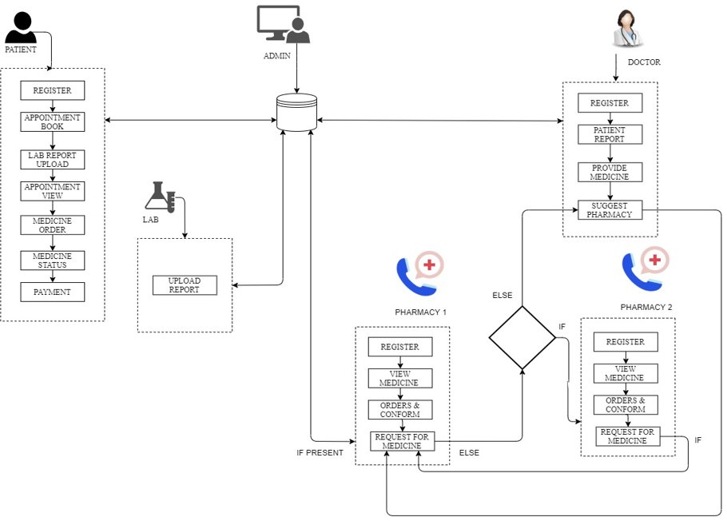



System Architecture

Slide 13
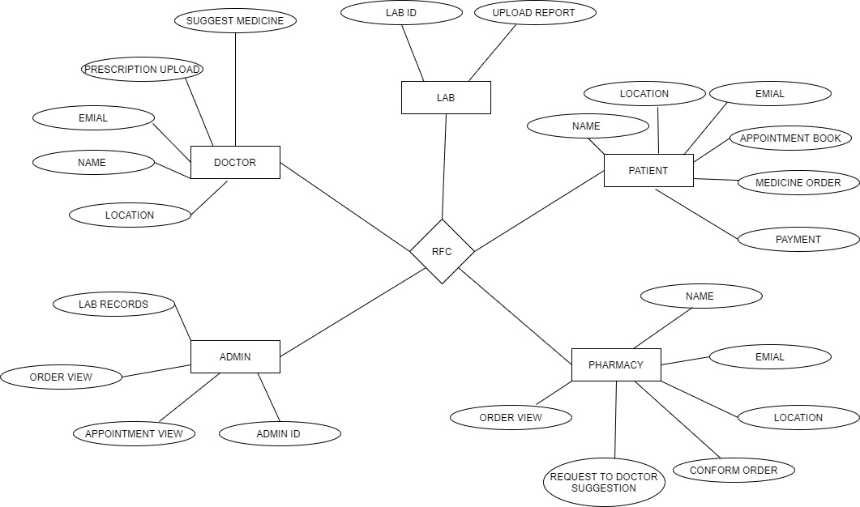
ER diagram

Slide 14
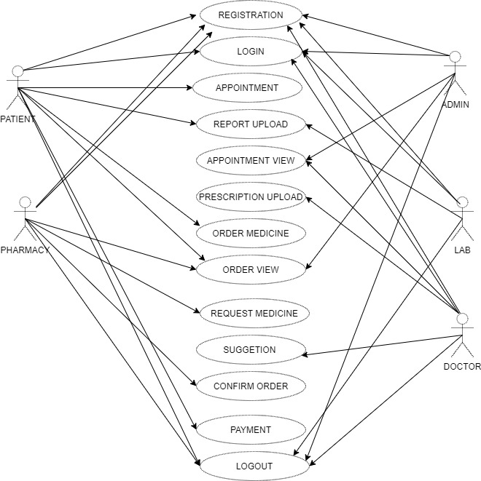
UML diagram

Slide 15
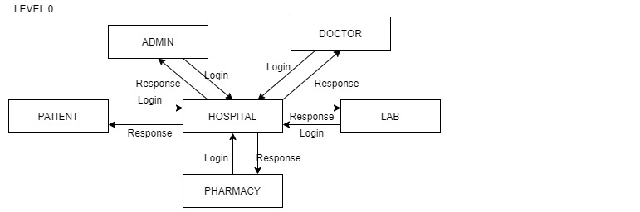
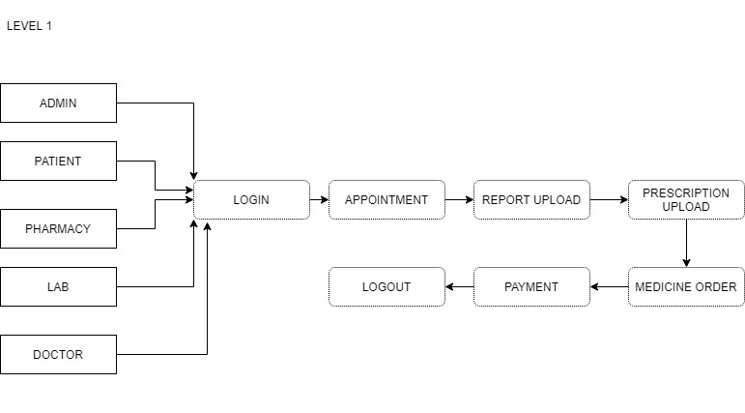
DFD diagram

Slide 16
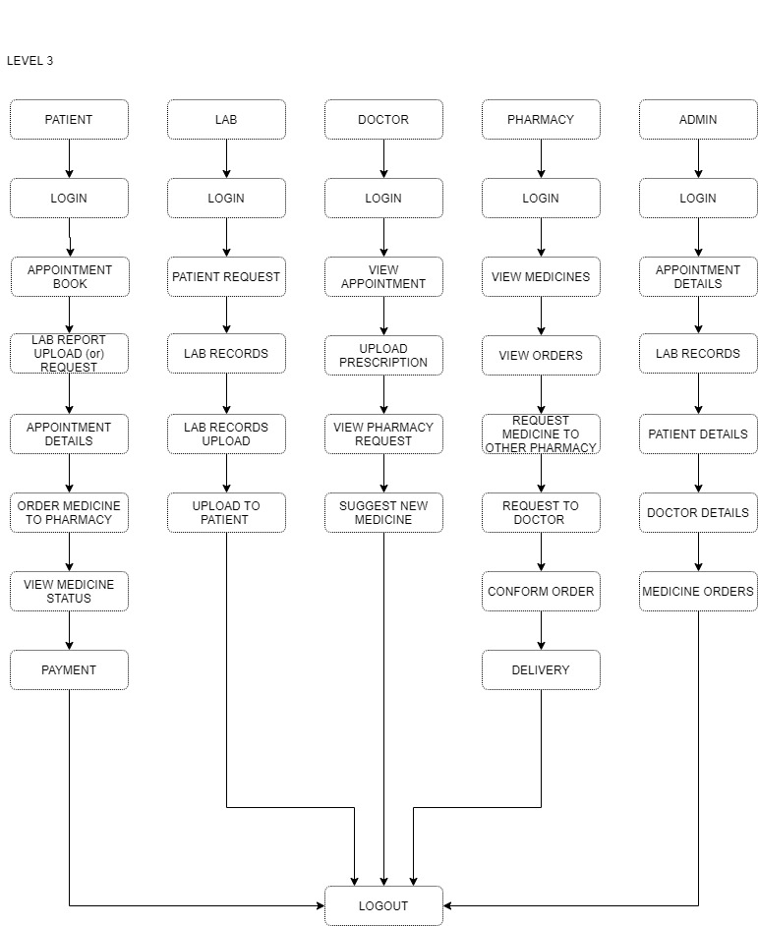
DFD diagram

Slide 17
Algorithm
Random Forest is a famous Machine learning algorithm that belongs to the supervised learning method. it is able to be used for both class and Regression issues in ML. It is based on the idea of ensemble studying, that's a procedure of combining a couple of classifiers to solve a complicated trouble and to improve the performance of the version.
In this project Random Forest Algorithm was used for predicting the accurate tablet.
The pharmacy rises the request to suggest the alternate tablet to the Doctor by using the desired tablet name it forms the various decision tree and give the accurate tablets list for the doctor for suggestion.
The Working process can be explained in the below steps and diagram:
Step-1: First get the tablet name with dosage from the pharmacy.
Step-2: Build the decision trees associated with the selected Tablet (Subsets).
Step-3: Choose the number N for decision trees for tablet needed.
Step-4: Repeat Step 1 & 2.
Step-5: For new Tablets, find the predictions of each decision tree, and assign the new data points to the category that wins the majority votes.

Slide 18
Modules Description
Consulting Doctor:
This module provides information about the patients and complete details, If the patient new to the applications means they want to register for this application after they can access this application easily.
The patient can register details with proper validation and all the fields will be required for the registration process.
The patient can fill the appointment form and upload the test results.
Patient downloads prescription and sent a request to pharmacy for buy medicine using the prescription uploaded by doctor.
Once the payment was completed the patient receives the medicines from pharmacy.

Slide 19
Modules Description Cont.
Suggesting Medicines:
This module provides information about the patients and complete details, If the patient new to the applications means they want to register for this application after they can access this application easily.
The patient can register details with proper validation and all the fields will be required for the registration process.
The patient can fill the appointment form and upload the test results. If patient didn’t have a test results send request to lab.
The appointment form was completed. If the doctor can check the form and test result then doctor upload the prescription for patient.
Patient downloads prescription and sent a request to pharmacy for buy medicine.
Once the payment was completed the patient receives the medicines from pharmacy.

Slide 20
Modules Description Cont.
Rising request for medicines:
This module provides information about the pharmacy and completes details.
If the pharmacy new to the application means they want to register for this application after they can access this application easily.
The pharmacy can register the details with proper validation and all the fields will be required for the registration process. The pharmacy can view the medicine request from patient.
All medicine presents the pharmacy sent a bill to patient. If medicine not presented pharmacy sent request to other pharmacy to buy the particular medicine then sent a bill to patient.
If the medicines has not presented in other pharmacy then the pharmacy sent a request to doctor for changing the medicine.

Slide 21
Modules Description Cont.
Upload tested lab reports:
This module provides information about the lab and complete details.
If The lab can upload the every patient test report to the application.
If patient request for test report then the lab sent the report to patient.
The lab can manage the test reports.

Slide 22
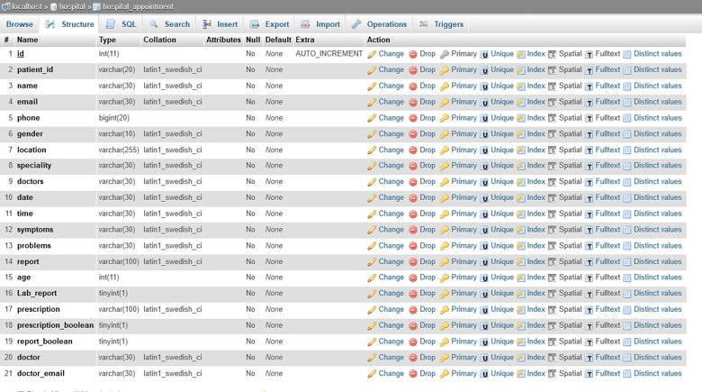
Database design

Slide 23

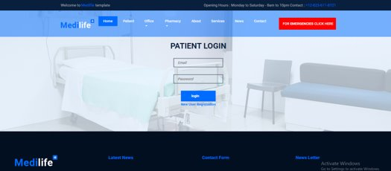
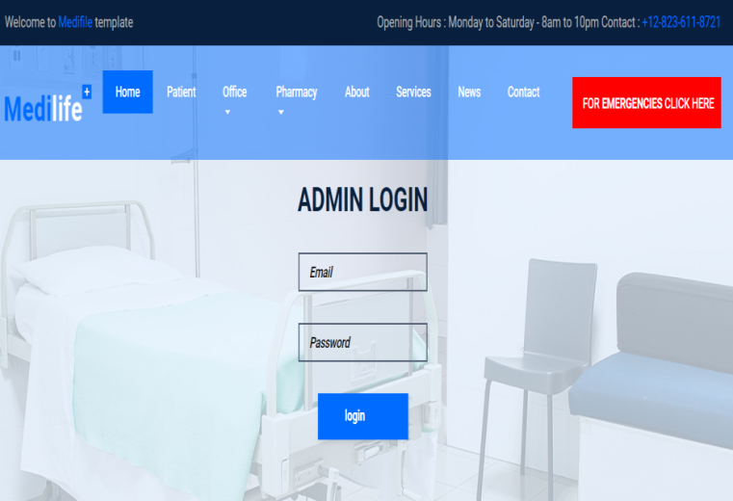
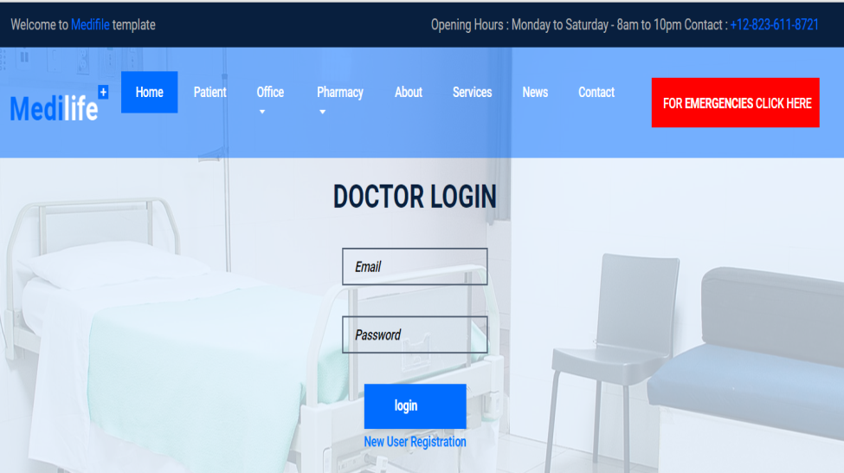
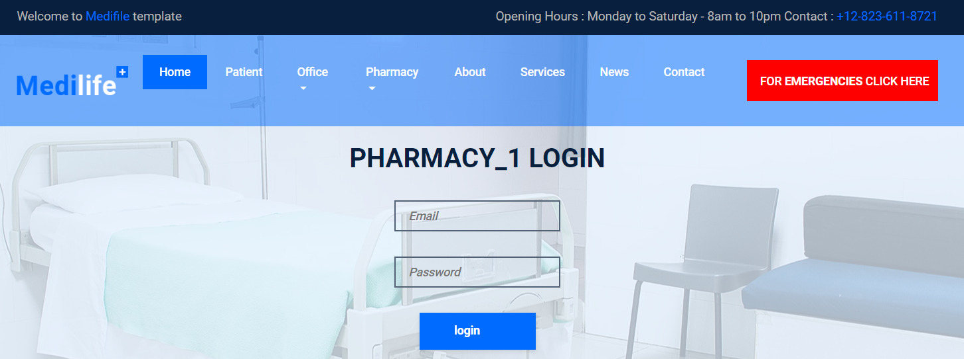
Sample Output
Home page
Patient Login
Admin Login
Doctor Login
Pharmacy Login

Slide 24
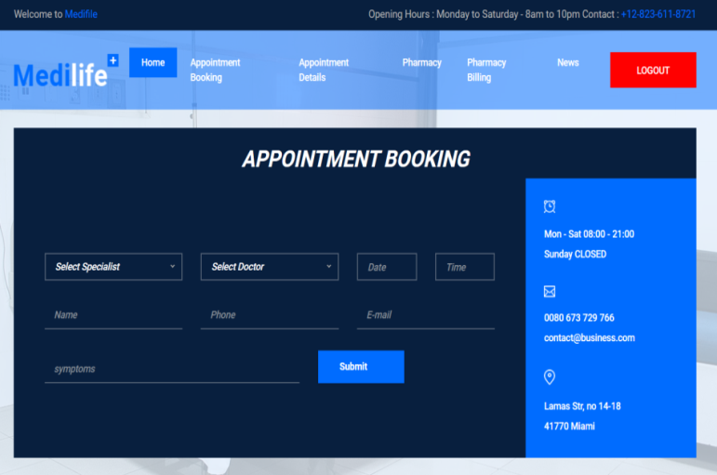
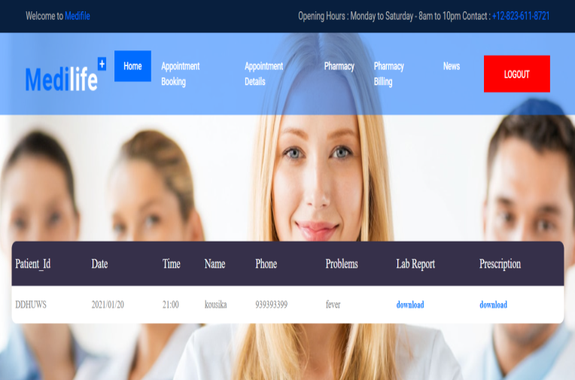
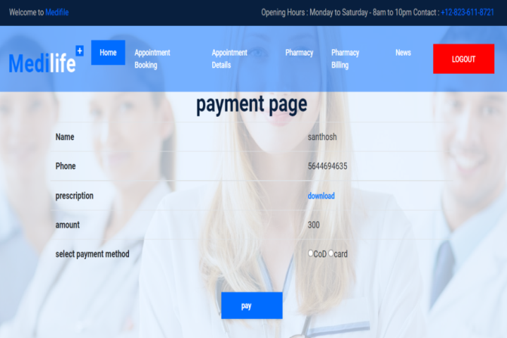
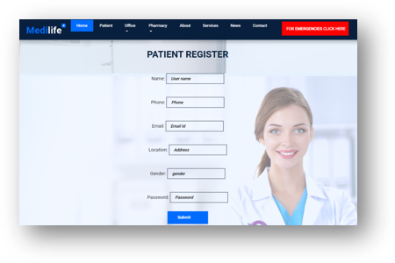
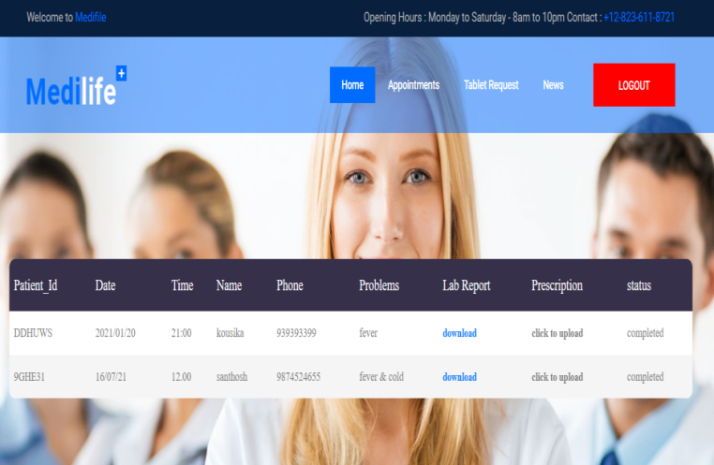
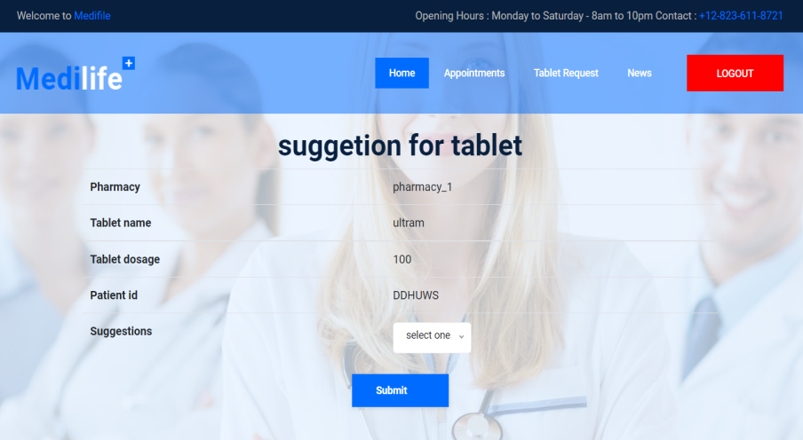
Sample Output
Appointment page 1
Appointment page 2
Patient Pay bill
Patient Registration
Doctor appointment view
Doctor suggest tablets

Slide 25
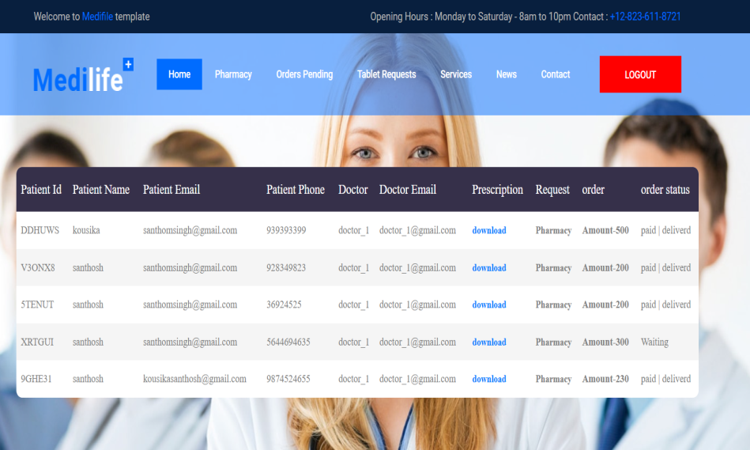
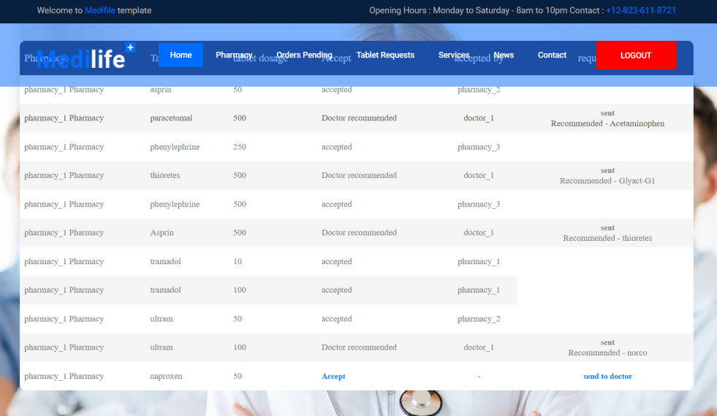
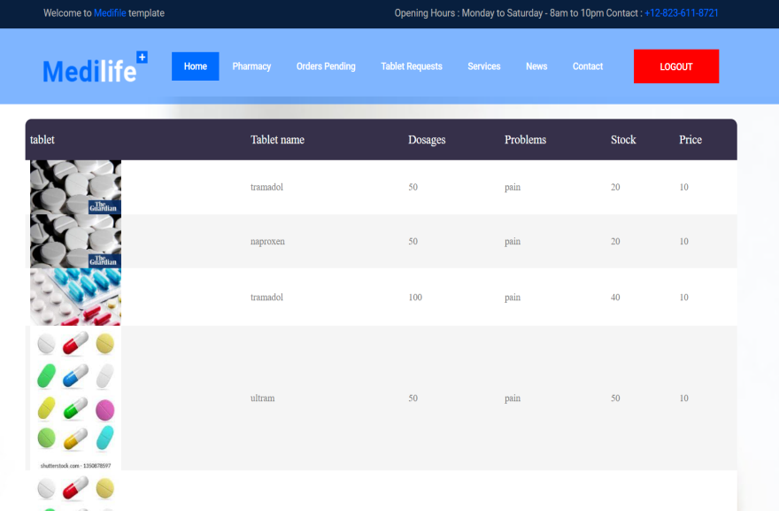
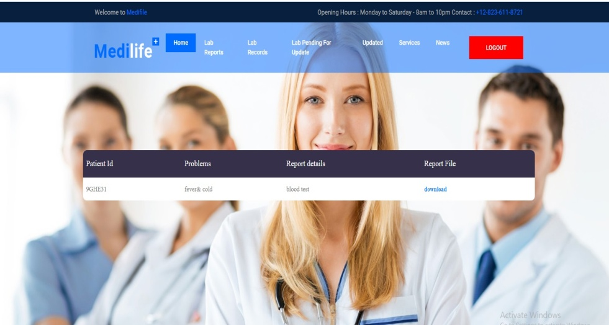
Sample Output
Pharmacy request for tablet
Pharmacy view suggested tablets
Pharmacy Stock list
Lab upload reports

Slide 26
Conclusion & Future Enhancement
In this application, I have presented a text processing using targeted analysis model with reinforcement learning.
The proposed approaches show not only good classification performance but accuracy has improved compared to existing.
In future I will add more medicine and improve accuracy.
I have shown experimentally that approach has robust against different levels of noise in contrast to five comparative methods.
In future studies, my intention is to extend the proposed approaches to a wider range of applications to further demonstrate their feasibility for practical use.

Slide 27
References
IEEE PAPER:TAM: Targeted Analysis Model With Reinforcement Learning on Short Texts
Mitchell, Tom (1997). Machine Learning. New York: McGraw Hill. ISBN 0-07-042807-7. OCLC 36417892.
Hu, J.; Niu, H.; Carrasco, J.; Lennox, B.; Arvin, F., “Voronoi-Based Multi-Robot Autonomous Exploration in Unknown Environments via Deep Reinforcement Learning” IEEE Transactions on Vehicular Technology, 2020.
Schapire, Robert E. (1990). “The Strength of Weak Learnability” (PDF). Machine Learning. 5 (2): 197–227. CiteSeerX 10.1.1.20.723. doi:10.1007/bf00116037. S2CID 53304535. Archived from the original (PDF) on 2012-10-10. Retrieved 2012-08-23.
“Guide To Data Cleaning: Definition, Benefits, Components, And How To Clean Your Data”. Tableau. Retrieved 2021-10-17.
Pyle, D., 1999. Data Preparation for Data Mining. Morgan Kaufmann Publishers, Los Altos, California.

